Slide 1

Files and NumPy
OPTIMIZATION LAB
2021-12-17

Slide 2


Content
NumPy Arrays review (again).
Permutations.
Traveling Salesman Problem.
Vehicle Routing Problem.
Introduction to PyPlot.

Slide 3
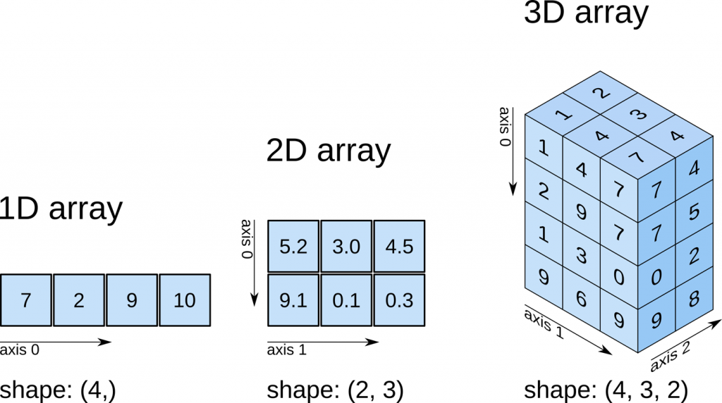
N-dimensional arrays indexing

Slide 4
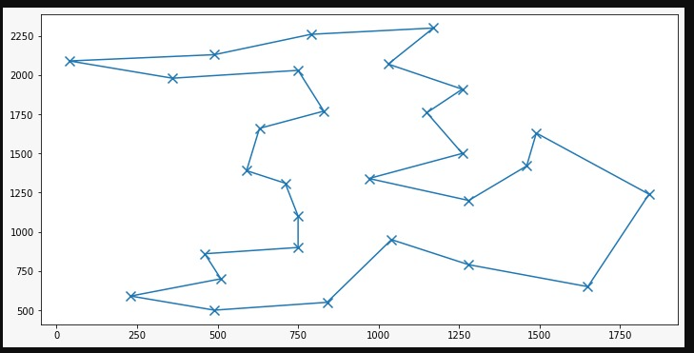
Travel Salesman Problem
The traveler must visit all cities!
Each city can be visited only once.
The traveler must return to the origin.

Slide 5
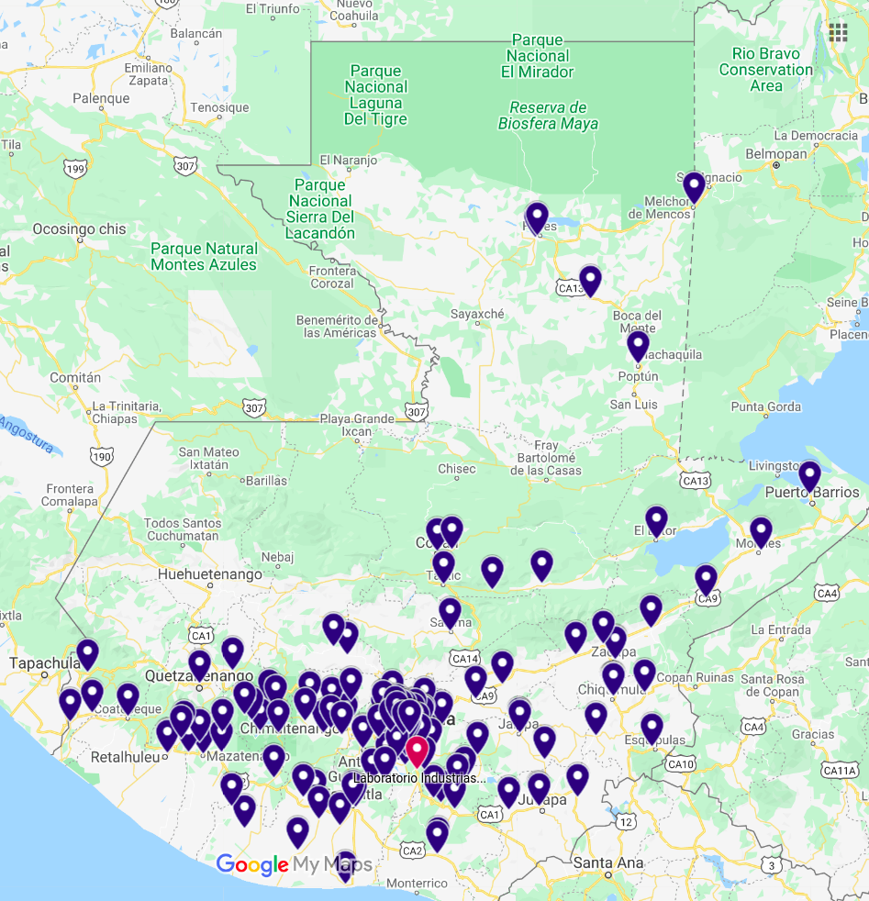
Vehicle Routing Problem
Select the routes for each trip that minimizes transportation costs, starting and ending each trip at production plant, subject to fleet’s capacity constraints (max cargo, max traveling distance).

Slide 6
Matplotlib
Library to create visualizations.
PyPlot submodule:
High-level utilities to plot

